Slide 1
AUTOMATIC STREET LIGHT CONTROL SYSTEM

Slide 2
TEAM MEMBERS
Durgeshwar Reddy (1602-20-735-131)
Sai charan (1602-20-735-152)
Sri Chandana (1602-20-735-165)

Slide 3
CONTENTS:
Introduction
Components
Components description
Circuit diagram
Hardware connections
Code
Statistics
Advantages
References

Slide 4
INTRODUCTION
The street lights are the major requirements in today’s life for safety purposes and avoiding accidents during night .Lighting can account for 10-38% of the total energy bill in typical cities worldwide.
Street light controllers are smarter versions of the mechanical or electronic timers previously used for street light ON-OFF operation
Energy efficient technologies and designs can cut street light costs drastically.
The main concept is to provide economical, power saving, accidental free life style, reduced manual work in which people feel they can walk in hours of darkness.

Slide 5
COMPONENTS
Arduino
Resistor - 4.7k
LDR -1
LED
Bread Board
Connecting Wires

Slide 6
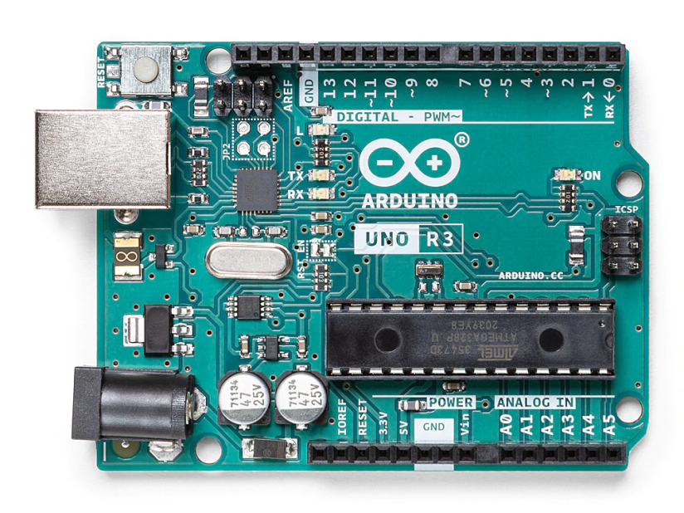
ARDUINO
Arduino is an open-source platform used for building electronic projects.
It consist of both physical programmable circuit board and a piece of software.
It has 14 digital input and output pins, 6 analog inputs, USB connection ,a power jack,and more.

Slide 7
Why we used arduino?
Code can be easily loaded into it using USB cable.
Uses simplified version of language , c++
Economical
RESISITORS
Resistors are passive elctronic components which limits the flow of electrons in a circuit.
Why resistors?
It is used inorder to safeguard the LED from damage.

Slide 8
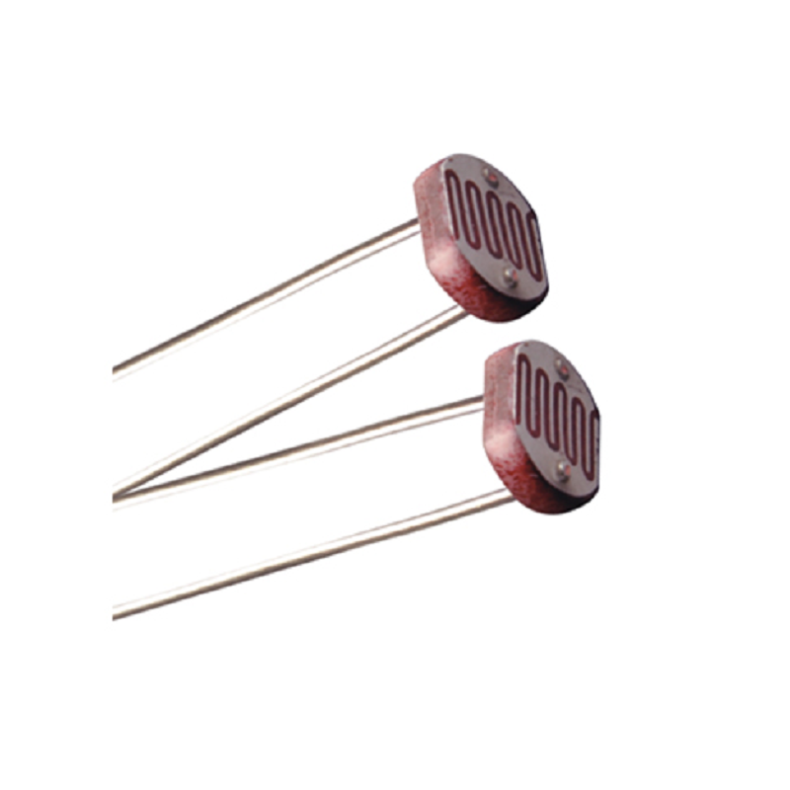
LDR (LIGHT DEPENDENT RESISTOR)
An LDR is a component that has a variable resistance ,changes with the light intensity that falls upon it.
Why we used LDR?
It automatically switches ON lights when the sunlight goes below the visible region of our eyes.
It automatically switches OFF lights when Sunlight fall on it.

Slide 9
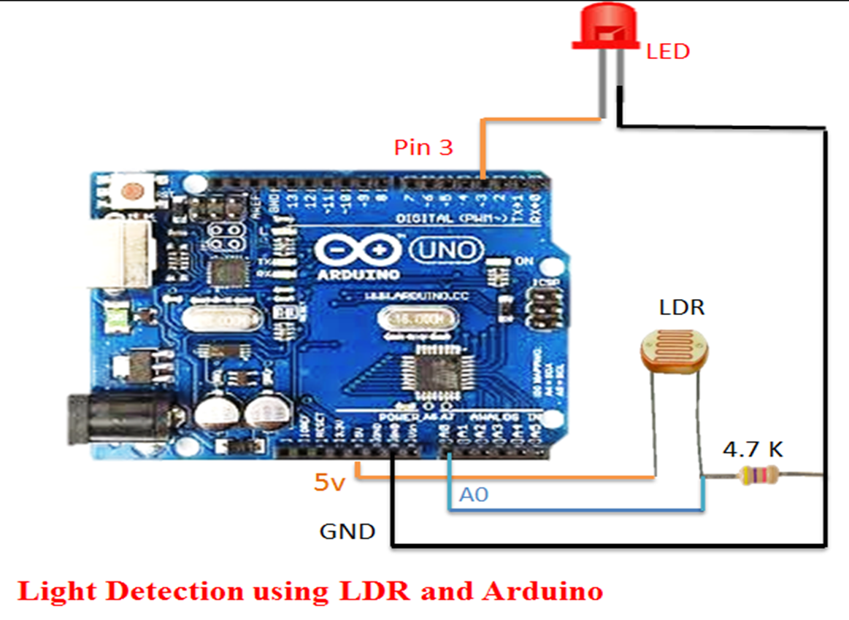
CIRCUIT DIAGRAM

Slide 10
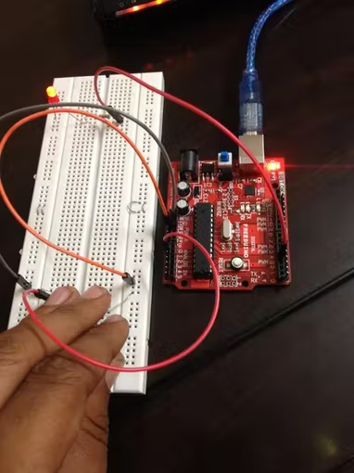
CONNECTED CIRCUIT

Slide 11
HARDWARE CONNECTIONS
Arduino 3rd pin connected to LED +ve.
Arduino GND connected to LED -ve through 4.7k.
Arduino +5v is connected to LDR one end
Arduino A0 pin is connected to LDR other end.
Arduino GND is connected to LDR other end with 4.7k.

Slide 12
CODE
#include <SoftwareSerial.h>
int sensorPin = A0; // select the input pin for the LDR
int sensorValue = 0; // variable to store the value coming from the sensor
int led = 3;
void setup()
{ // declare the ledPin as an output
pinMode(led, OUTPUT);
Serial.begin(9600);
}
void loop()
{
Serial.println("Welcome to TechPonder LDR Tutorial"); sensorValue = analogRead(sensorPin);

Slide 13
CODE
Serial.println(sensorValue);
if (sensorValue < 100)
{
Serial.println("LED light on");
digitalWrite(led,HIGH);
delay(1000);
}
digitalWrite(led,LOW);
delay(sensorValue);
}

Slide 14
STATISTICS
Let us consider a road with 10 street lights of each 50 Watt .(summer season)
MANNUAL OPERATION
AUTOMATIC OPERATION
The fixed time of operation will be from 5 PM to 5 AM(12 hrs).
Total power consumed 12hrs*10*50(Watt)=6Kwh.
If cost of 1 kwh=Rs.5 then for 6Kwh it is Rs.30
The time of operation will get reduced from 12hrs to 9hrs.
Total power consumed=9hrs*10*50(Watt)=4.5kwh.
If cost of 1Kwh=Rs.5,then for 4.5Kwh it is Rs.22.5

Slide 15
STATISTICS
In metropolitan cities , there are lakhs of street lights operating per day. So through our assumed statistics a huge difference in amount is evident (approximately lakhs per day).

Slide 16
ADVANTAGES :
Energy efficient
Less cost
Economical
No manual work required
Power saving
Accidental free
Low chances of overheating

Slide 17
REFERENCES
http://logixproject.weebly.com/uploads/4/2/3/5/42350931/automatic_street_light_control.pdf
https://www.circuiteasy.com/automatic-street-light

Slide 18
THANK YOU!!!!

